Slide 1
Founding for success
Esther and Juli

Slide 2
Dataset |“Startup Insights (2012-2021)”
Source: Kaggle
Where and in which industry are the highest valued startups founded?
Hypotheses
Most startups are from the US
US startups have the highest valuations
The highest valued startups are in AI or data industries

Slide 3
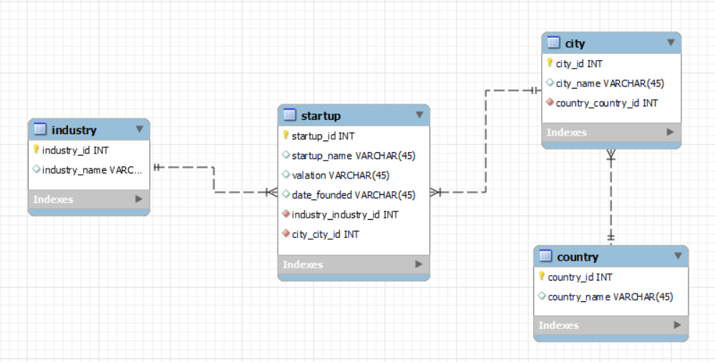
Entity Relationship Diagram

Slide 4
Challenges
Preparation of data before SQL (indexes, foreign keys, create multiple tables).
Clear understanding of data upload process (which options and how to tackle each one).
Populating the foreign keys with the data in SQL

Slide 5
H1
Most startups are from the US

Slide 6
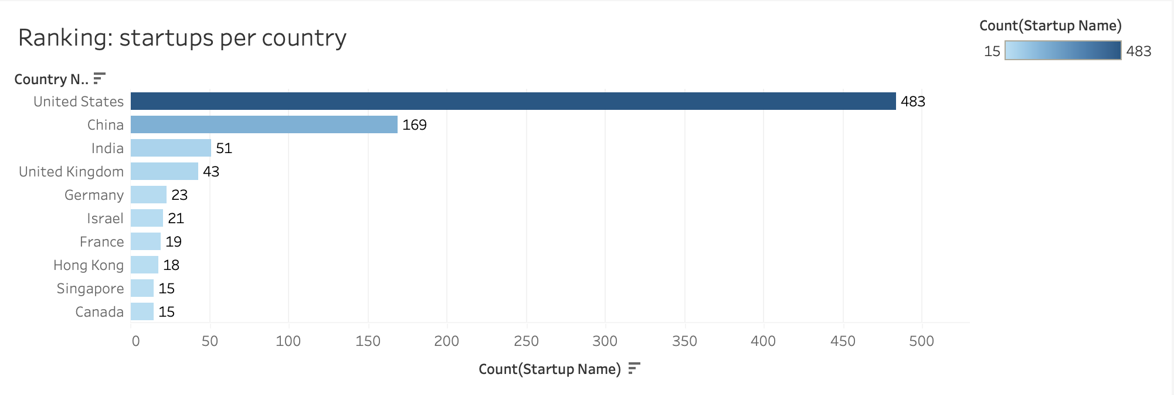

Slide 7
H2
US startups have the highest valuations

Slide 8
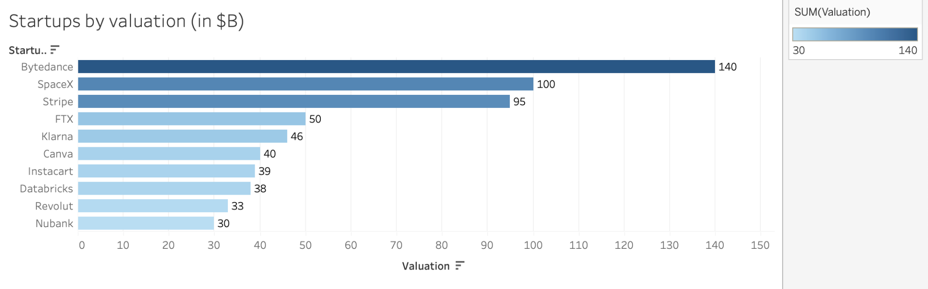

Slide 9
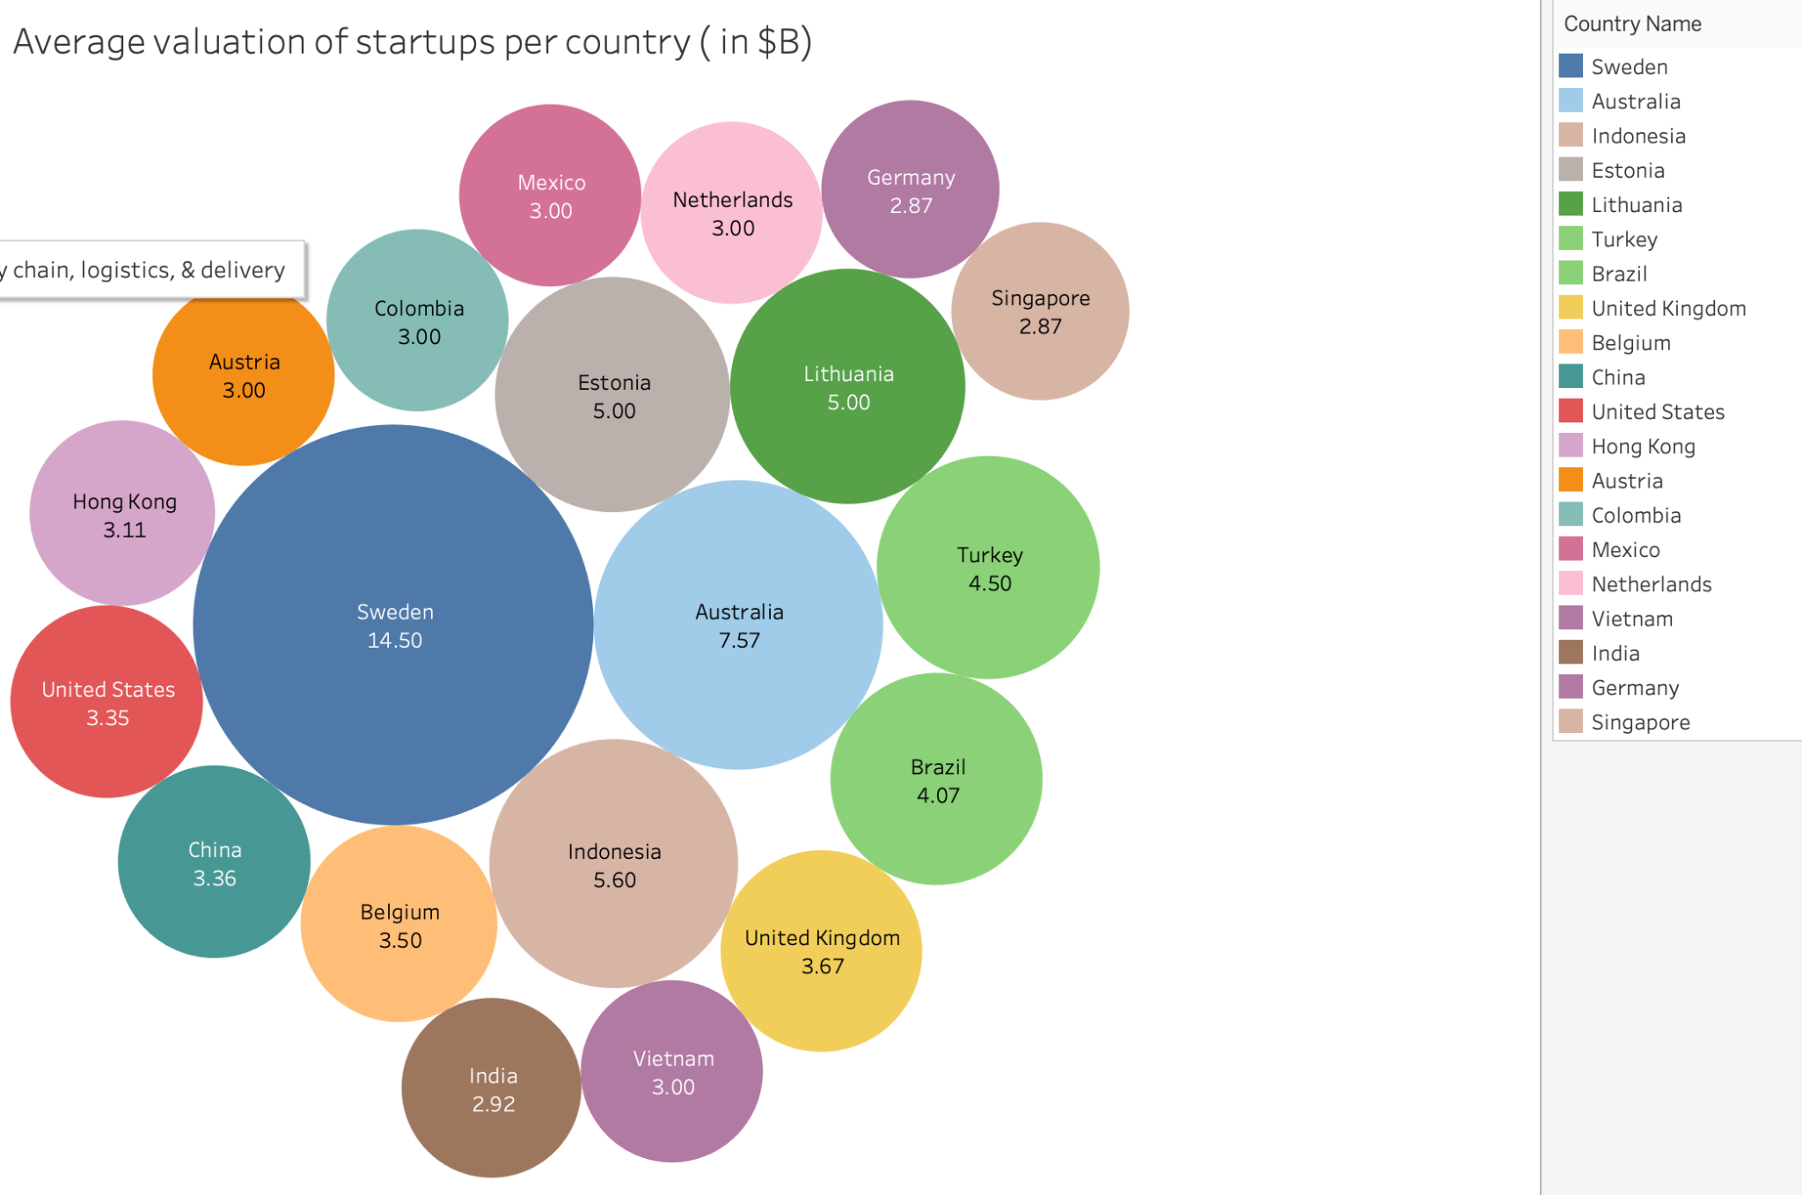

Slide 10
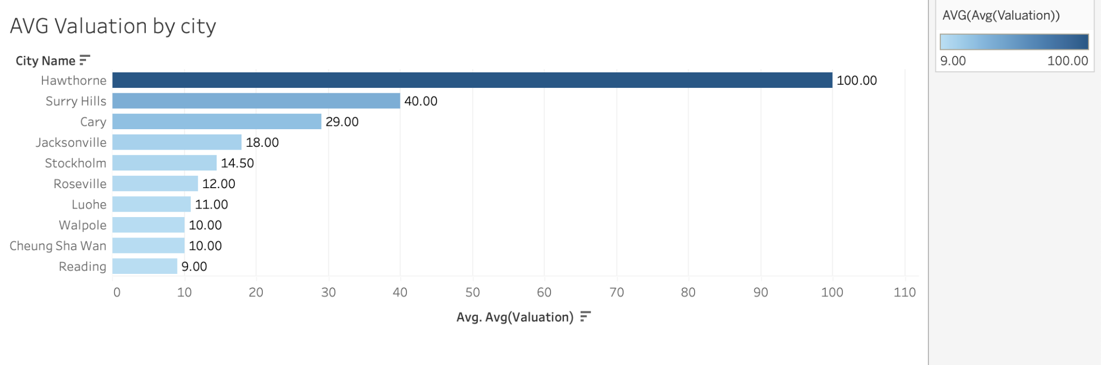






Slide 11
H3
The highest valued startups are in AI or data industries

Slide 12
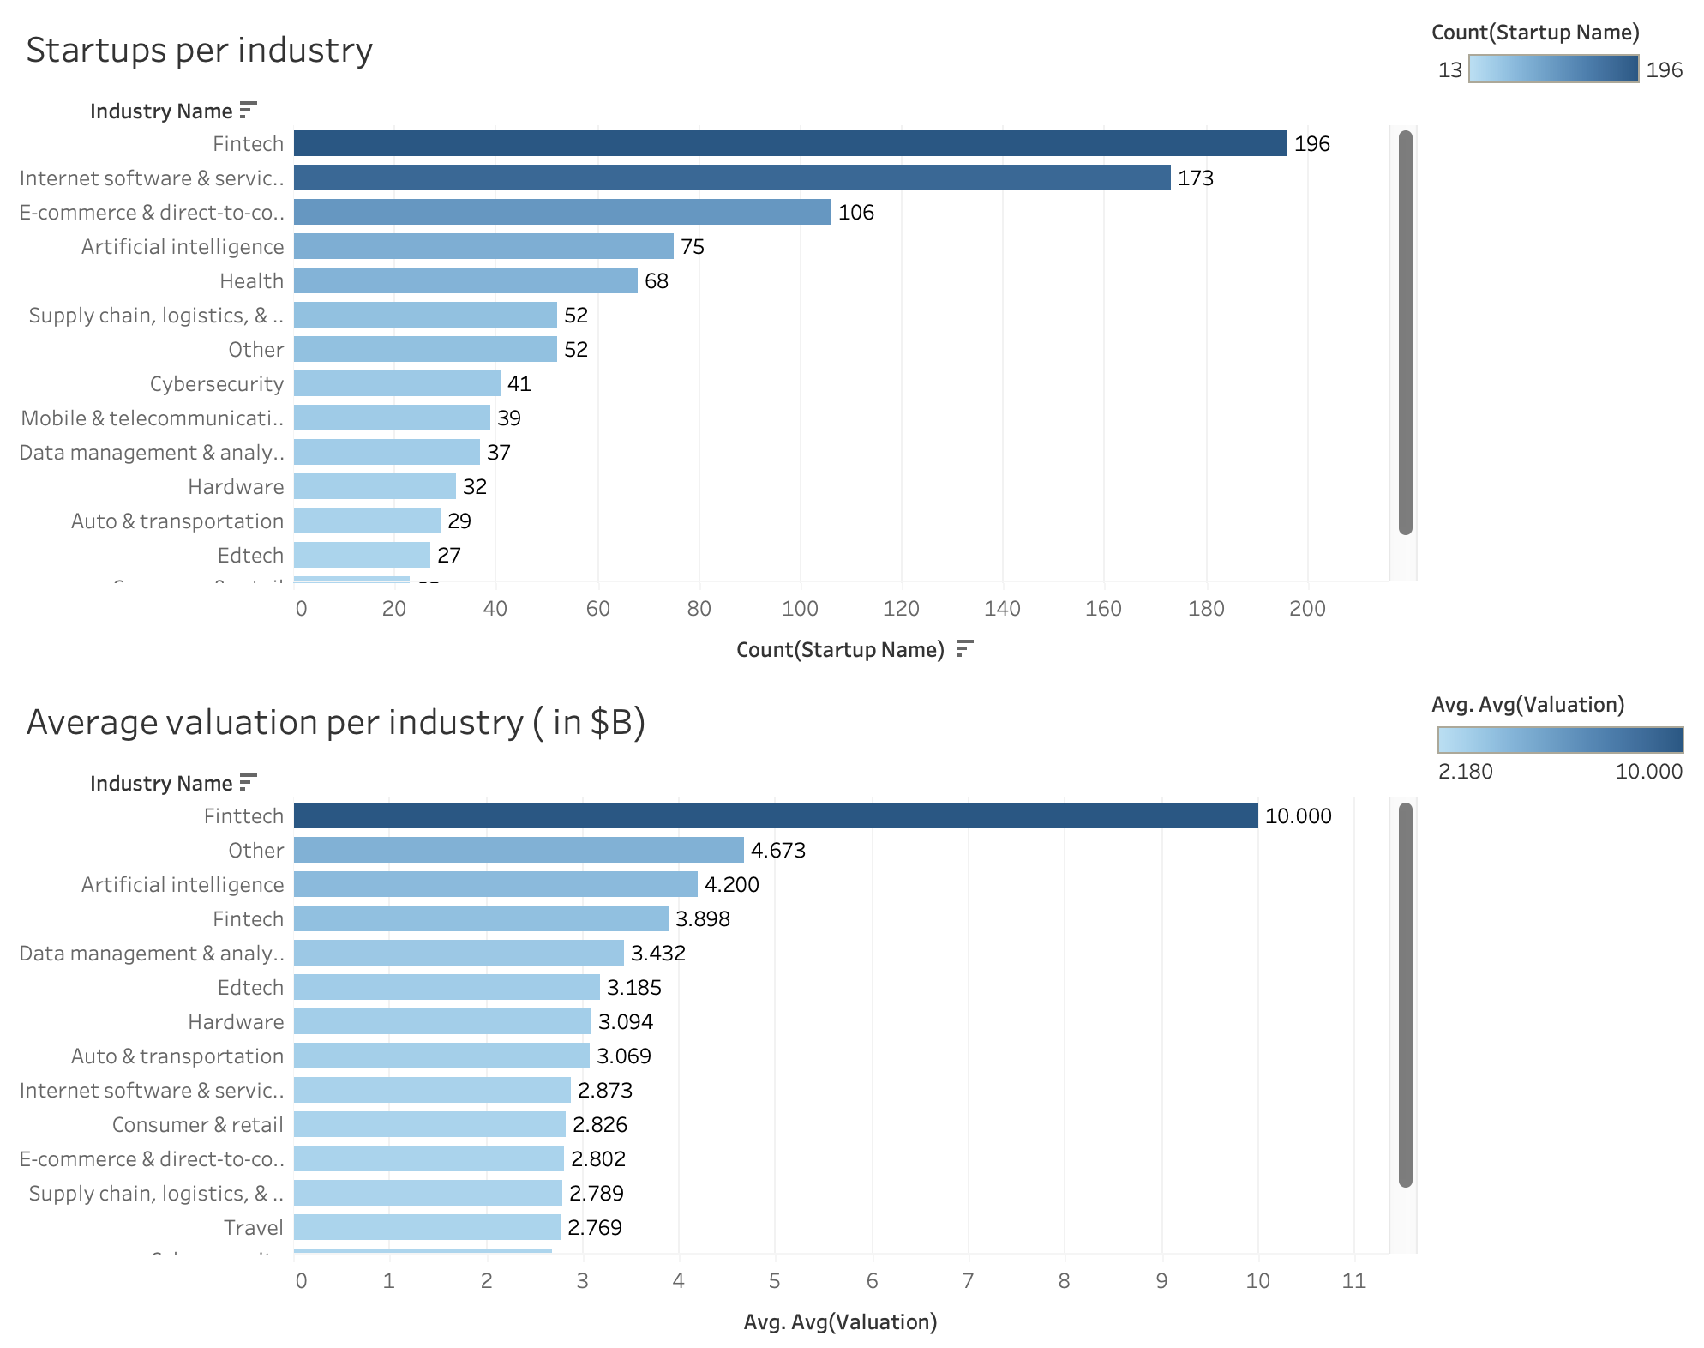

Slide 13
Conclusion
Better quality than quantity.
And in Fintech.

Slide 14
Thank you!
Do you have any questions?

